Slide 1


M.Tech Program
Advanced Industry Integrated Programs
Jointly offered by University and LTIMindTree
Hybrid Recommendation System for Mobiles
Team Member
Sai Likhitha Bollu
M tech (Artificial Intelligence and Machine Learning)
VIT Vellore
Knowledge partner | Implementation partner

Slide 2
Hybrid Recommendation System for Mobiles
Introduction
Mobile market flooded with choices.
Users face decision-making confusion.
Recommenders simplify product selection.
CF & CB have key limits.
Hybrid model solves major issues.

Slide 3
Hybrid Recommendation System for Mobiles
Objective
Design hybrid mobile recommender system
Combine content-based and collaborative filtering
Generate personalized phone suggestions

Slide 4
Hybrid Recommendation System for Mobiles
Scope
Build hybrid mobile recommender engine
Use content and collaborative filtering
Add explainability for user trust
Introduce serendipity in suggestions
Apply contrarian logic for discovery

Slide 5
Hybrid Recommendation System for Mobiles
Literature Review
[1] B. V. Chandrahaas, B. S. Panigrahi, S. D. Pande, and N. K. Swain, “A Hybrid Approach for Mobile Phone Recommendation using Content-Based and Collaborative Filtering,” EAI Endorsed Transactions on Internet of Things, vol. 10, pp. 1–6, Dec. 2023, doi: 10.4108/eetiot.4594.
[2] P. K. Biswas and S. Liu, “A Hybrid Recommender System for Recommending Smartphones to Prospective Customers,” Unpublished manuscript, Verizon Communications, New Jersey, USA, 2022. [Online]. Available: arXiv:2105.12876v2.

Slide 6
Hybrid Recommendation System for Mobiles
Literature Review
[3] M. Caro-Martínez, G. Jiménez-Díaz, and J. A. Recio-García, “Conceptual Modeling of Explainable Recommender Systems: An Ontological Formalization to Guide Their Design and Development,” Journal of Artificial Intelligence Research, vol. 71, pp. 557–589, Jul. 2021.
[4] Y. Tokutake and K. Okamoto, “Serendipity-Oriented Recommender System with Dynamic Unexpectedness Prediction,” in Proc. IEEE Int. Conf. on Systems, Man, and Cybernetics (SMC), Oahu, Hawaii, USA, Oct. 2023, pp. 1247–1252, doi: 10.1109/SMC53992.2023.10394368.

Slide 7
Hybrid Recommendation System for Mobiles
Literature Review
[5] A. Smets, L. Michiels, T. Bogers, and L. Björneborn, “Serendipity in Recommender Systems Beyond the Algorithm: A Feature Repository and Experimental Design,” in Proc. IntRS’22: Joint Workshop on Interfaces and Human Decision Making for Recommender Systems, CEUR Workshop Proceedings, vol. 3222, 2022. [Online]. Available: http://ceur-ws.org/Vol-3222/paper4.pdf

Slide 8
Hybrid Recommendation System for Mobiles
Summary of Literature
Hybrid model improves mobile recommendations using TF-IDF.
ALS and DNN combined for smartphone prediction.
Ontology formalizes explainability in recommender systems.
Reranking boosts serendipity using time-series prediction.
Interface design shapes serendipitous user experiences.

Slide 9
Hybrid Recommendation System for Mobiles
Summary of Literature
Cold-start addressed using hybrid deep learning.
Ontology guides explainable recommender system design.
User-specific serendipity acceptance improves relevance.
Serendipity influenced by UI and content.
Experimental design proposed for serendipity evaluation.

Slide 10
Hybrid Recommendation System for Mobiles
Research Gap
Existing systems ignore explainability and user trust.
Serendipity rarely implemented beyond theoretical models.
Contrarian logic missing in practical recommenders.
Cold-start and over-specialization still unresolved issues.
Hybrid models lack mobile-specific recommendation focus.

Slide 11
Hybrid Recommendation System for Mobiles
Modules
Data Handler
Content-Based Filtering
Collaborative Filtering
Hybrid Recommender
Explainability
Serendipity and Contrarian Logic
User Interface

Slide 12
Hybrid Recommendation System for Mobiles
Modules
Data Handler Module
Loads and preprocesses mobile phone dataset and user input.
Handles missing values and formats data for filtering.
Content-Based Filtering Module
Uses TF-IDF and cosine similarity to match user preferences with phone features.
Generates a relevance score for each item.

Slide 13
Hybrid Recommendation System for Mobiles
Modules
Collaborative Filtering Module
Analyzes user-item interaction matrix (e.g., purchase history).
Identifies similar users to recommend unseen but relevant phones.
Hybrid Recommender Module
Combines outputs from content-based and collaborative filters.
Uses meta-level hybridization to refine and rank recommendations.

Slide 14
Hybrid Recommendation System for Mobiles
Modules
Explainability Module
Provides human-readable reasons for each recommendation.
Enhances transparency and user trust.
Serendipity & Contrarian Logic Module
Introduces relevant but unexpected suggestions.
Challenges user biases to promote discovery and avoid filter bubbles.

Slide 15
Hybrid Recommendation System for Mobiles
Modules
User Interface Module (CLI or GUI)
Collects user preferences (optional per feature).
Displays top 10 personalized recommendations with explanations.

Slide 16
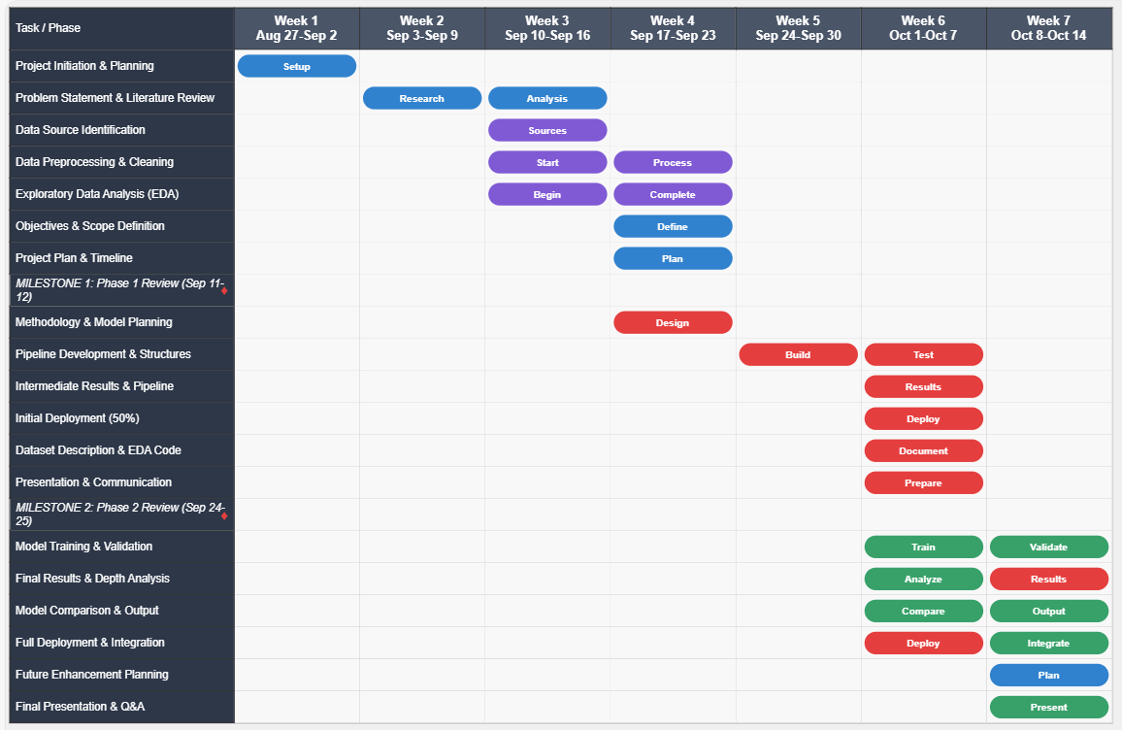
Hybrid Recommendation System for Mobiles
Modules to cover

Slide 17
Hybrid Recommendation System for Mobiles
Dataset
Sourced from : Real World Smartphone's Dataset – Gigasheet
General Product Info & Display
Performance & Hardware
Battery & Charging
Connectivity
Camera

Slide 18
Hybrid Recommendation System for Mobiles
Additional Information…. Calibri body -36
Calibri body 28

Slide 19
Hybrid Recommendation System for Mobiles
Literature Review - 1
Title and Authors | Core Methodology | Strengths | Limitations
A Hybrid Approach for Mobile Phone Recommendation using Content-Based and Collaborative Filtering | Combines content-based filtering (TF-IDF, VSM) with collaborative filtering. Uses user behavior and phone features for personalized recommendations. Applies traditional machine learning techniques for ranking. | Tailored for mobile phone market complexity. Delivers precise recommendations using proven methods. | Lacks deep learning or advanced explainability features. Focuses only on standard accuracy metrics (MSE, MAE).

Slide 20
Hybrid Recommendation System for Mobiles
Literature Review - 2
Title and Authors | Core Methodology & Key Concepts | Strengths | Limitations
A Hybrid Recommender System for Recommending Smartphones to Prospective Customers | Combines Alternating Least Squares (ALS) based collaborative filtering with a Deep Neural Network (DNN). The system uses the output of the ALS model to influence the DNN's recommendations, and it integrates "side information" and external embeddings from Word2Vec and Universal Sentence Encoder (USE) to enhance performance. | The hybrid architecture effectively addresses the "cold start" problem by using side information. The integration of deep learning and word embeddings allows for a richer understanding of textual data. The system is flexible and scalable for big data frameworks. | The provided abstract lacks specific quantitative results, making it difficult to fully assess the claimed performance improvements.

Slide 21
Hybrid Recommendation System for Mobiles
Literature Review - 3
Title and Authors | Core Methodology & Key Concepts | Strengths | Limitations
A Hybrid Recommender System based on Word Embedding and Clustering of Online Customer Reviews | This system processes online customer reviews using word embedding (Word2Vec) and clustering techniques to generate product-feature words and detect sentiment. Attributes extracted from text data and word embeddings are combined to create a hybrid representation of products. | Provides a method for using unstructured data (customer reviews) to enrich product representations. It helps overcome data sparsity issues by creating a hybrid representation. | The paper focuses on general products and does not specify its application to mobile phones. The effectiveness is dependent on the quality and volume of online reviews.

Slide 22
Hybrid Recommendation System for Mobiles
Literature Review - 4
Title and Authors | Core Methodology & Key Concepts | Strengths | Limitations
Serendipity in Recommender Systems Beyond the Algorithm: A Feature Repository and Experimental Design | Shifts the focus of serendipity from a purely algorithmic problem to a broader user experience. The methodology introduces a "feature repository" that identifies system design elements (related to content, UI, and information access) that contribute to serendipitous encounters. An experimental design is outlined to evaluate these features. | Provides a comprehensive, user-centric framework for designing serendipitous systems. The feature repository is a valuable tool for systematic research and design. It tackles the problem of "over-specialization" and "popularity bias." | The paper is preliminary and does not present empirical results; it only outlines the methodology. The repository is acknowledged as non-exhaustive.

Slide 23
Hybrid Recommendation System for Mobiles
Literature Review - 5
Title and Authors | Core Methodology & Key Concepts | Strengths | Limitations
Explainable recommendation attempts to develop models that generate not only high-quality recommendations but also intuitive explanations. | A survey paper that defines explainable recommendation as providing the "why" behind a recommendation. The explanations are intended to improve the transparency, persuasiveness, effectiveness, and trustworthiness of recommender systems for both users and system designers. | Offers a comprehensive overview of the field and its importance. Highlights the benefits of explainability, such as building user trust and assisting with system debugging. | As a survey, it does not propose a specific new methodology or provide empirical results from a new system. It serves as a foundational theoretical work.

Slide 24
Hybrid Recommendation System for Mobiles
Literature Review - 6
Title and Authors | Core Methodology & Key Concepts | Strengths | Limitations
A Conceptual Model for Explanations in Recommender Systems | Proposes a conceptual model formalized as an ontology to guide the development of effective explanations. This model enhances existing taxonomies by adding new concepts related to the explanation's goal, user's expectation, available knowledge, and presentation method. | Provides a structured, integrating framework for designing explanations. The formalization as an ontology allows for systematic and reproducible development. It moves beyond the idea that explainability is a simple feature and proposes it as a core design requirement. | The provided text does not explicitly state any weaknesses of the model. Its strength lies in its theoretical contribution rather than a practical implementation.

